Slide 1
Final Presentation
Jacob Heglund
AE 598 – Advanced Navigation Systems

Slide 2
Motivation
Original Project Goal – Way too ambitious
Develop a simulated autonomous car that could solve the navigation task in an environment filled with obstacles
Modified Project Goal – Too many different topics
Examine low-level and high-level navigation tasks

Slide 3
Motivation
Final Project Goal
Develop end-to-end pipelines for detecting lane lines from camera images on a road vehicle
Learn about classical CV and it’s application in modern autonomous vehicles

Slide 4
Work Done
Developed three pipelines for detection of lane lines
Each builds on the techniques developed in the last iteration
Each pipeline utilizes classical CV methods, no deep learning
All data taken from a front-mounted camera on a car on the highway
This simplifies the problem, only dealing with 1 sensor

Slide 5
Results

Slide 6
Pipeline #1

Slide 7
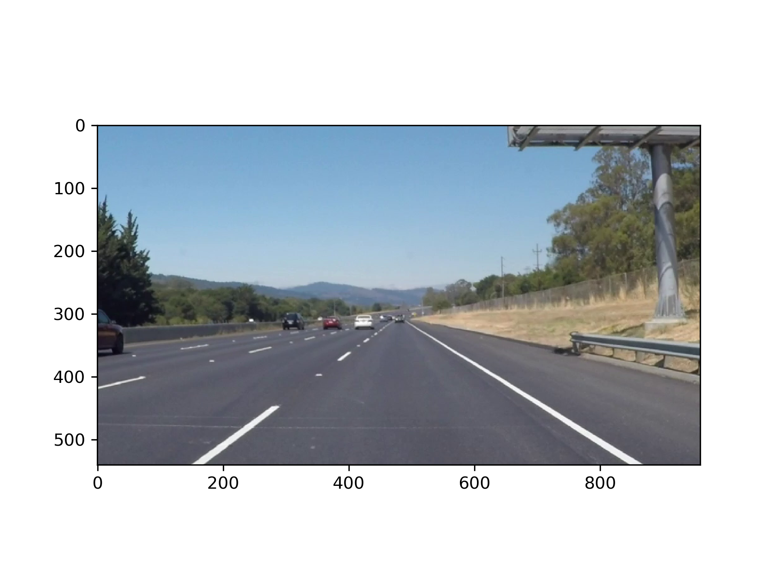
Pipeline #1 – Outline
Identify lanes based on 2 factors
position
color

Slide 8
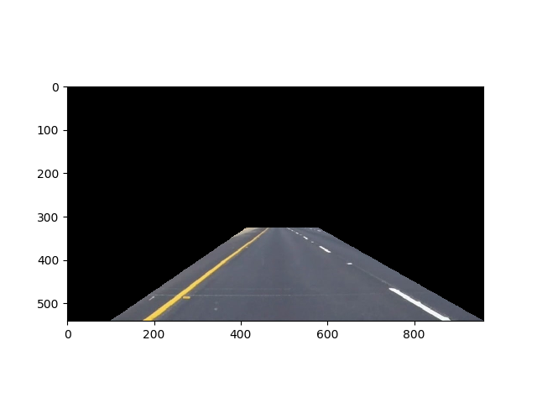
Pipeline #1
Region of Interest
Assumptions
The lane lines up with the front of your car
Assumption Breaks
Going up a steep hill
Sharp corners
No visible lane lines
Your car is upside down

Slide 9
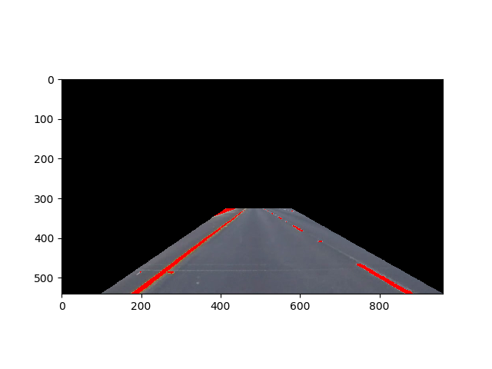
Pipeline #1
Color Threshold
White and yellow are bright in the R channel of RGB color space
Set a threshold that only leaves the lane marker pixels
Can also examine other color spaces (HSV, LUV, LAB)

Slide 10
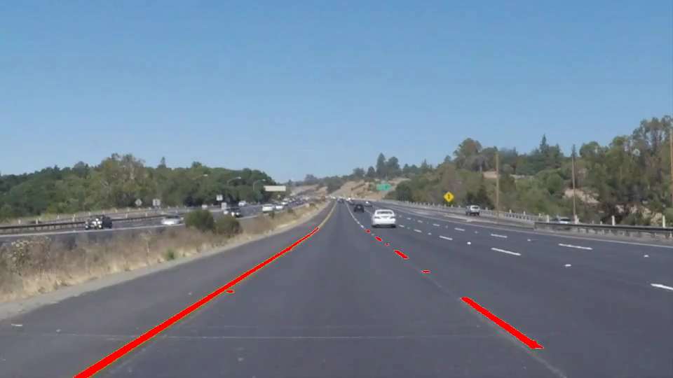
Pipeline #1

Slide 11
Pipeline #1 - Discussion
Even with a simple pipeline, there are several parameters we could tune
Region of interest size can be adaptive
How to select a color threshold?
What if it is a cloudy day?
What if night time? Street lights?
This method doesn’t clearly define a lane
We have only identified pixels that may or may not be at the edge of the lane

Slide 12
Pipeline #2

Slide 13
Pipeline #2 – Outline
Want to identify groups of pixels that fit along edges
Region of Interest
Grayscale + Gaussian Blur
Improves edge detector performance
Canny Edge Detection
Hough Transform
This finds lines at a certain angle within the image

Slide 14
Pipeline #2
Starting Image

Slide 15
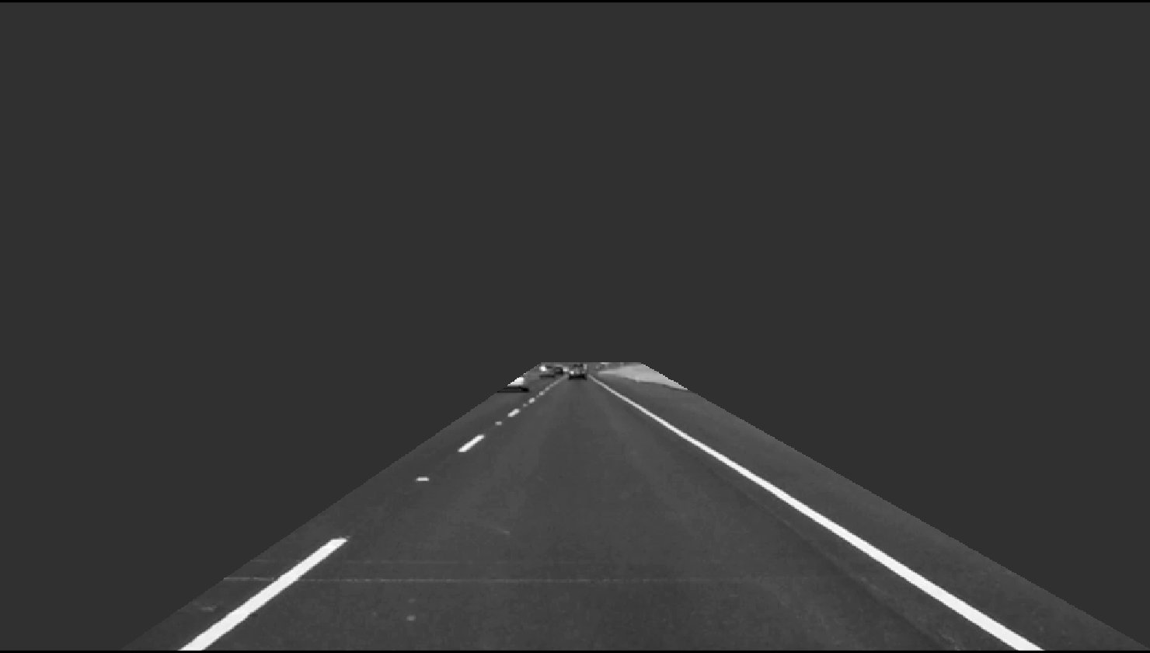
Pipeline #2
Region of Interest + Grayscale + Gaussian Blur

Slide 16
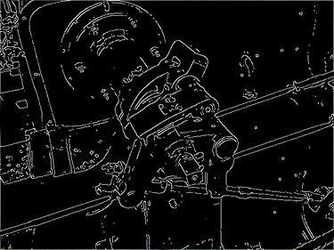
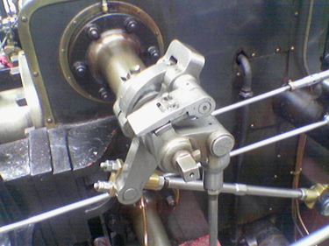
Pipeline #2
Canny Edge Detection
Finds areas of high gradient in the image
Very similar to a Sobel edge detector

Slide 17
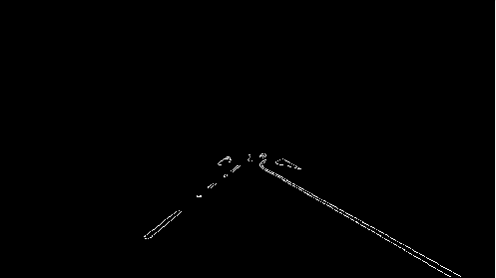
Pipeline #2
Canny Edge Detection

Slide 18
Pipeline #2
Hough Transformation – OpenCV
searches image for lines with a particular slope and intercept
allows you to choose the minimum line length and max gap
returns a set of lines
if positive slope, the line is part of the left lane marker
if negative slope, the line is part of the right lane marker
Assumptions
The lane markers are all running roughly in the same direction
The lane markers have consistent spacing
Assumption Breaks
Construction zones
Corners

Slide 19
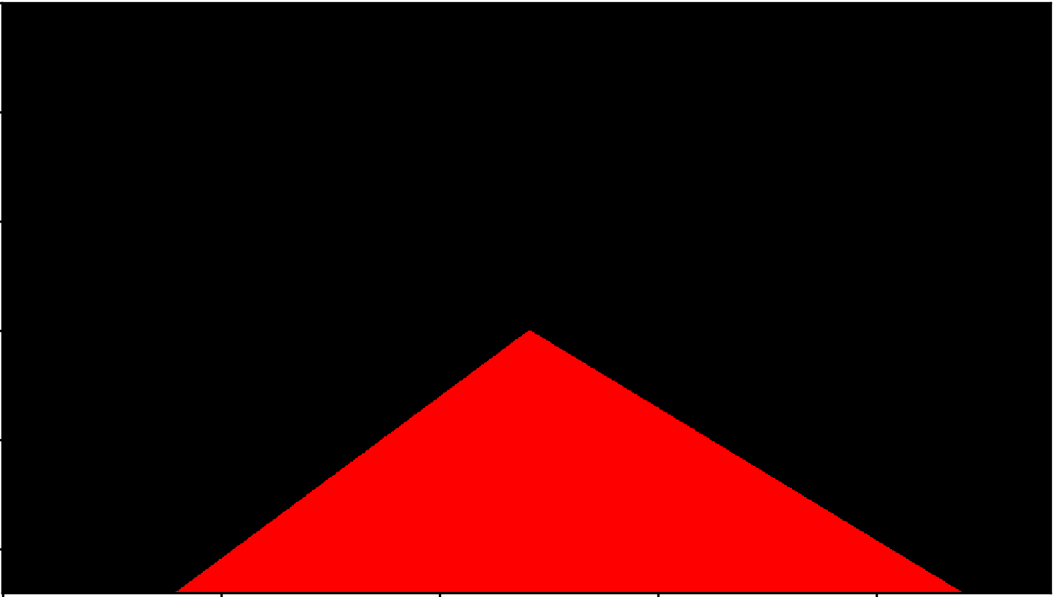
Pipeline #2
Take the average of all points in the lane marker, and find the best linear fit through these points
this linear fit will be our best approximation of the lane marker
Color the region between these two lines

Slide 20
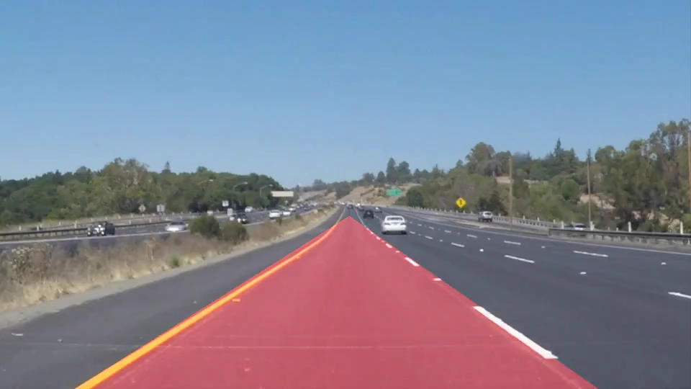
Pipeline #2

Slide 21
Pipeline #2 – Discussion
This method clearly improves by defining the lane boundaries
The method of line fitting is still very rudimentary
Applies more generalizable techniques
Fewer tunable parameters
Works well for still images, fast vehicle motion is filtered by averaging
The lane detector can be slow to respond
Application of Kalman filter w/ motion model of the vehicle?

Slide 22
Pipeline #3

Slide 23
Pipeline #3 – Outline
Use a more sophisticated method for identifying pixels in the lane lines
Binary Pipeline
Undistort (lens curvature)
Perspective Transform
Color Spaces
Canny Edge Detection
Line Fitting Pipeline
histogram
sliding windows for pixel detection

Slide 24
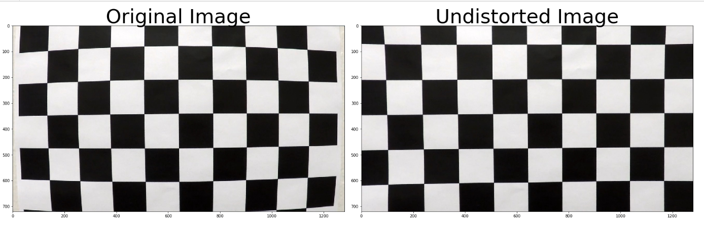
Pipeline #3
Correct for curvature in the camera lens
This will make the perspective transform easier to interpret

Slide 25
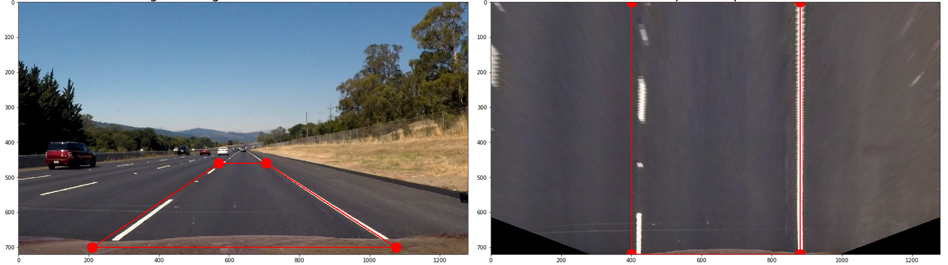
Pipeline #3
Perspective Transform
Turn the “lane points” into a rectangle
Car perspective -> birds-eye perspective
Allows easier enumeration of pixels in the lane line
Fewer pixels per area further from the camera, leads to distortion

Slide 26
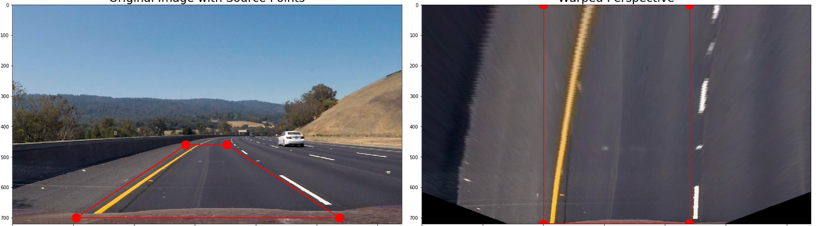
Pipeline #3
Perspective Transform

Slide 27
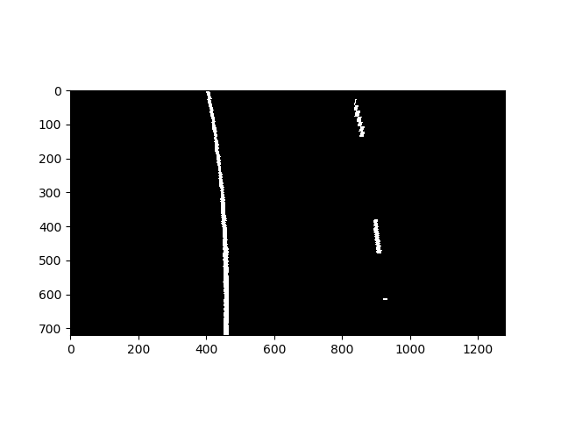
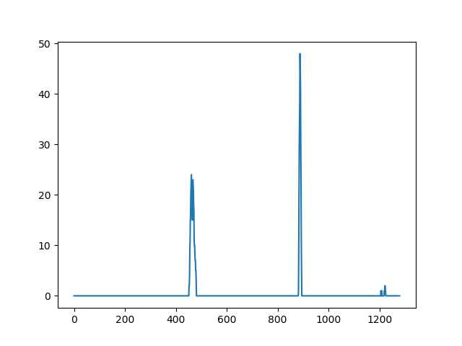
Pipeline #3
Color Spaces + Canny Edge Detection
Gives a binary image
Take a histogram of white pixels along the x-axis

Slide 28
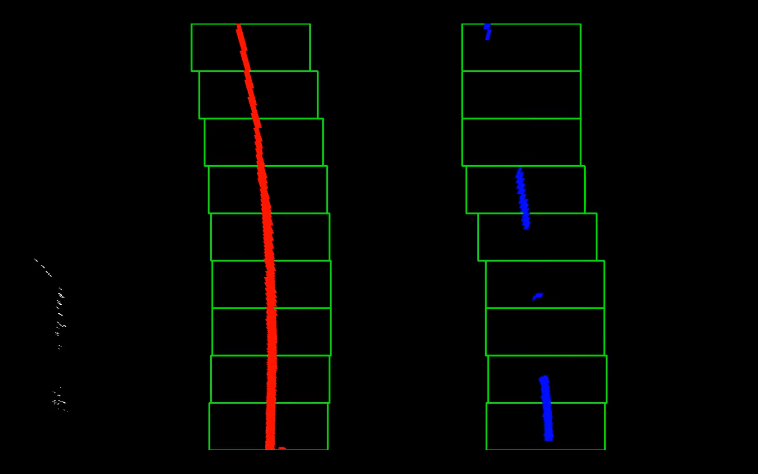
Pipeline #3
Sliding Windows Method
Identifies lane pixels that are not necessarily in a straight line
Start with the histogram peaks as window center
Move up N pixels, recompute the mean x-position

Slide 29
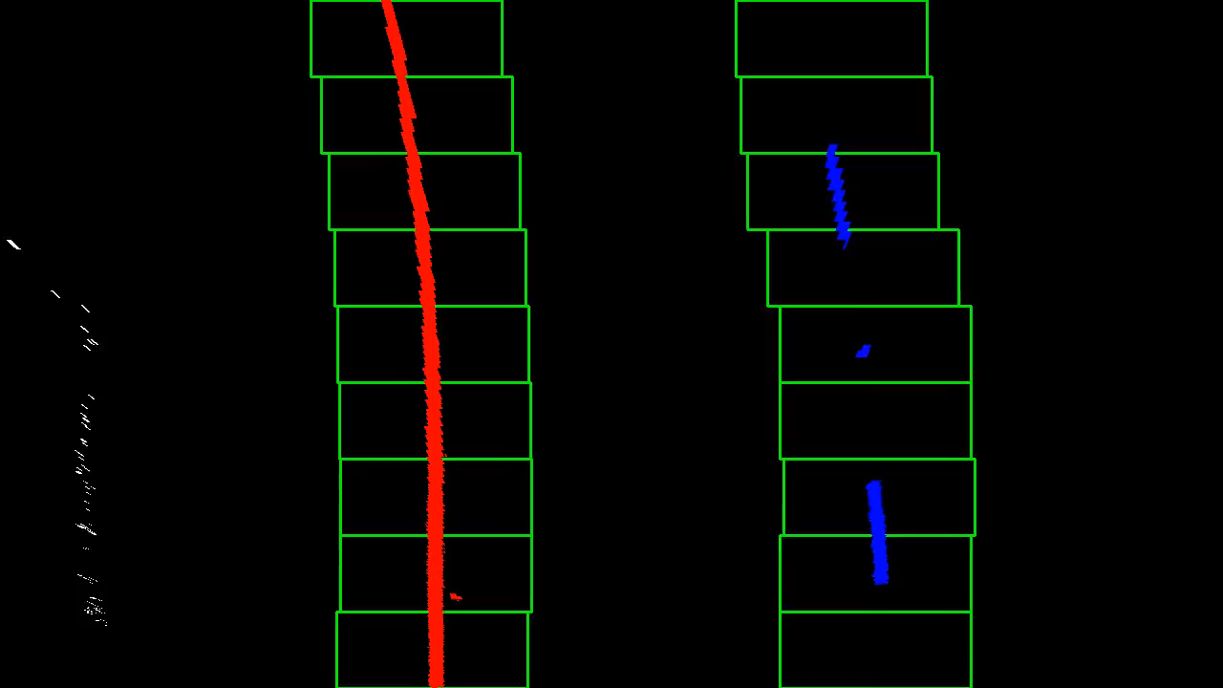
Pipeline #3

Slide 30
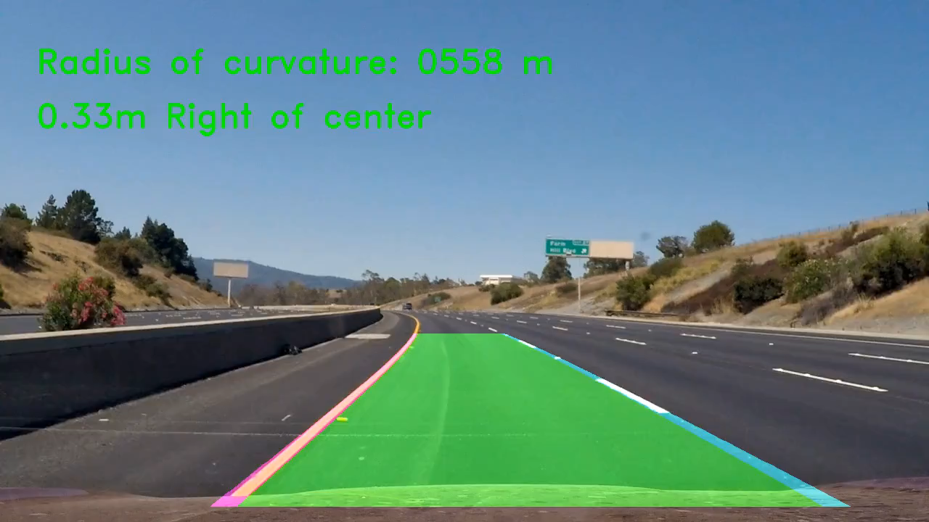
Pipeline #3
Fit 2nd order polynomial through lane pixels in a frame, and reverse the perspective transformation

Slide 31
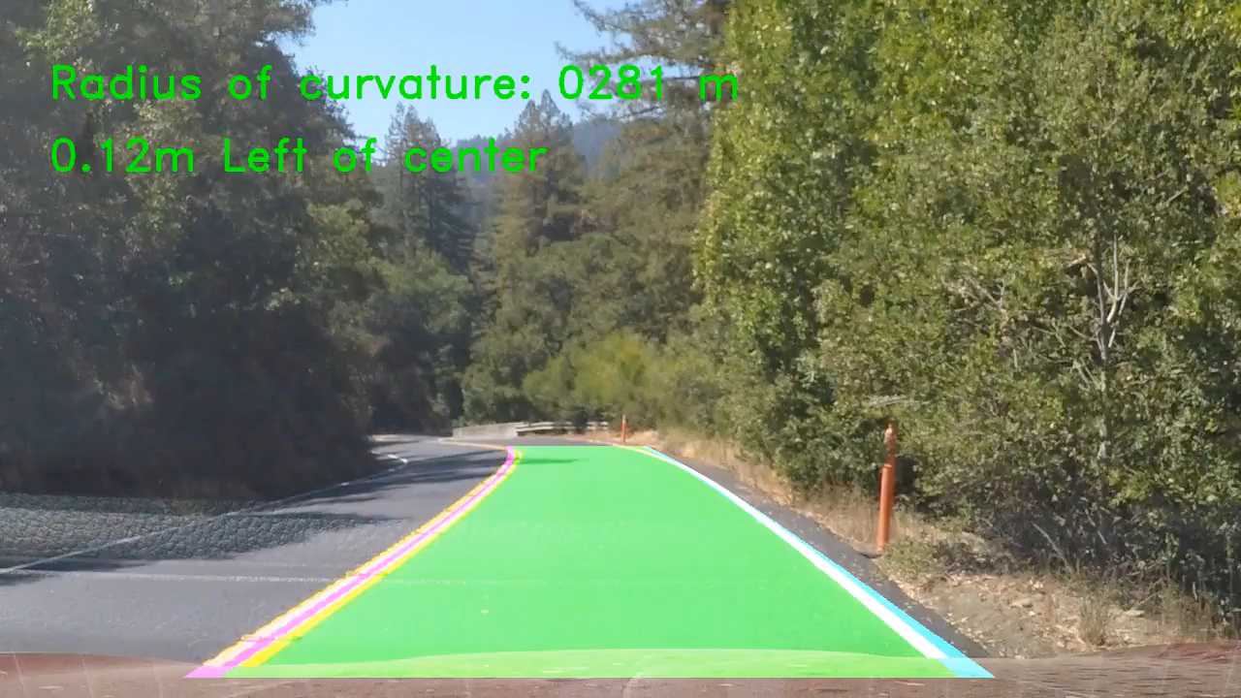
Pipeline #3
Job done? Not quite
Changing light conditions pose a challenge for our detector

Slide 32
Pipeline #3
Developed a pipeline that works well for highway situations
Light conditions don’t change rapidly
There are no quick turns
Pedestrians and other vehicles are not yet considered

Slide 33
Conclusions
Many heuristics in computer vision
Each problem has different valid assumptions
Human intuition is still an important part of the field
CV algorithms tend to have many tunable parameters
CNNs performs well in object recognition tasks
However, a well-designed CV pipeline can be just as effective, especially in prototyping stages
CV can also be easier to debug and requires fewer overall resources (datasets, computation, etc.)

Slide 34
Remaining Work
Improve robustness of classical CV in challenging situations
Particularly when shadows cover the road
Tuning parameters for different situations
Implement a detector performance metric and compare the accuracy of my implementations

Slide 35
Questions?

